Slide 1
Generative Adversarial Networks
Yining Xu 2018222050154
Communication and Information System

Slide 2
CONTENTS
01
02
03
Introduction
Network Structure
Application

Slide 3
Introduction
What is Generative Adversarial Network

Slide 4
Introduction
Generative adversarial network (GAN) is a class of machine learning systems. Two neural networks contest with each other in a zero-sum game framework.
The name "GAN" was introduced by Ian Goodfellow et al. in 2014. Their paper popularized the concept and influenced subsequent work.
GANs is used to generate real images and even videos. It is a great breakthrough in the development of Machine Learning.

Slide 5
Introduction
Generator & Discriminator
Generator is used to receive a random noise z and generate an image from this noise.
Discriminator is used to discriminate whether a picture is "real " or " fake".
Adversarial
G generate real image to deceive D. D try to identify the fake images(G) and real images(data).
Adversarial means a dynamic "gaming process", and end with a Nash equilibrium.
Purpose
Based on the real data, using the method of adversarial to generate the data which has the same distribution as the real data.

Slide 6
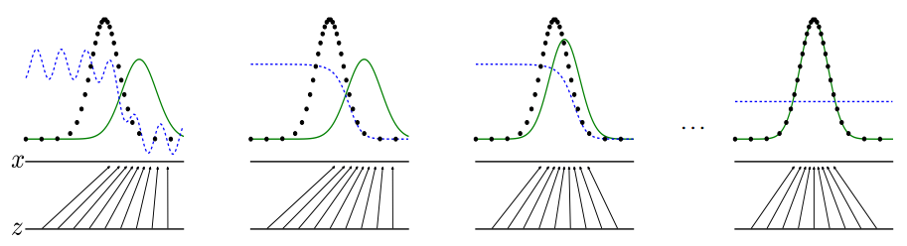
Introduction
Discriminator
Adversarial
Nash equilibrium
Generated data
Real data

Slide 7
Network Structure
What is GANs look like

Slide 8
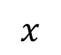

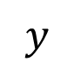
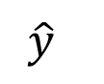
Network Structure
Normal CNNs
$$CNN$$
$$x$$
$$\hat{y}$$
$$y$$

Slide 9
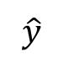
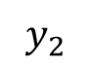

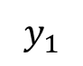
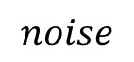
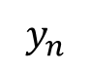
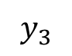
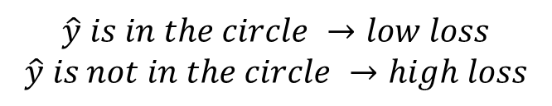
Network Structure
$$\hat{y} is in the circle →low loss$$
$$\hat{y} is not in the circle →high loss$$
GANs
$$y_{3}$$
$$Generator$$
$$noise$$
$$\hat{y}$$
$$y_{1}$$
$$y_{n}$$
$$y_{2}$$
Problem:
We cannot assign a target for every noise signal.
CLASSIFICATION!

Slide 10

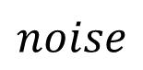
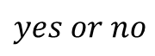

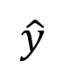
Network Structure
CNNs → GANs
loss calculator
$$Generator$$
$$Classifier$$
$$noise$$
$$\hat{y}$$
$$yes or no$$

Slide 11
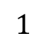

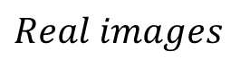
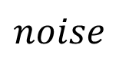
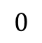
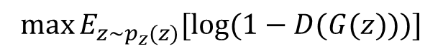

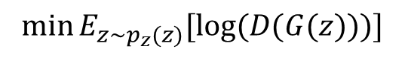
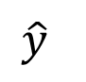
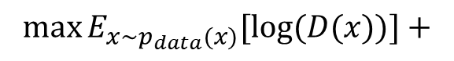
Network Structure
CNNs → GANs
$$Generator$$
$$noise$$
$$\hat{y}$$
$$0$$
$$Discriminator$$
$$Real images$$
$$1$$
$$\max{E_{x\sim p_{data}(x)}[log⁡(D(x))]}+$$
$$\min{E_{z\sim p_{z}(z)}[log⁡(D(G(z)))]}$$
$$\max{E_{z\sim p_{z}(z)}[log⁡(1−D(G(z)))]}$$
$$\max{E_{x\sim p_{data}(x)}\left[\log\left(D\left(x\right)\right)\right]+E_{z\sim p_{z}(z)}[log⁡(1−D(G(z)))]}$$

Slide 12
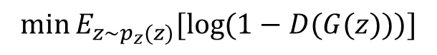
Network Structure
Adversarial
D →
$$\max{E_{x\sim p_{data}(x)}\left[\log\left(D\left(x\right)\right)\right]+E_{z\sim p_{z}(z)}[log⁡(1−D(G(z)))]}$$
G →
$$\min{E_{z\sim p_{z}(z)}[log⁡(1−D(G(z)))]}$$
$$\min{\max{E_{x\sim p_{data}(x)}\left[\log\left(D\left(x\right)\right)\right]+E_{z\sim p_{z}(z)}[log⁡(1−D(G(z)))]}}$$
G
D
adversarial

Slide 13
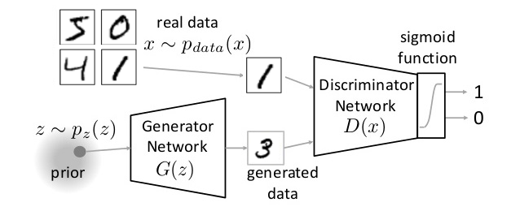
Network Structure
Network

Slide 14
Network Structure
Summary
Breakthrough —— learning distribution
Clear and better
Mode Collapse
Unstable training
Loss

Slide 15
Application
Application of GANs —— Image processing

Slide 16
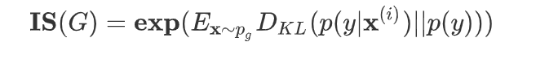
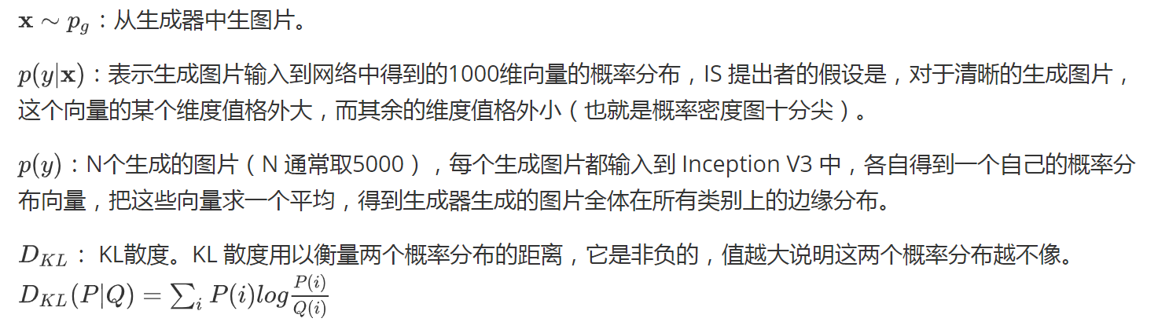
Application
Inception score（IS）

Slide 17
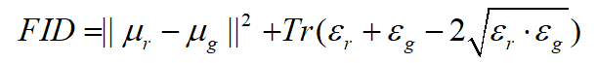
Application
Fréchet Inception Distance（FID）
Fréchet Inception Distance是2017年由 Martin Heusel 提出的用于计算生成图像和真实图像的距离。对真实图像和生成图像分别提取特征，再对比两种特征之间的分布差异。FID越小，则表示生成图片越接近真实图片，反之则生成图片和真实图片越不相似。

Slide 18
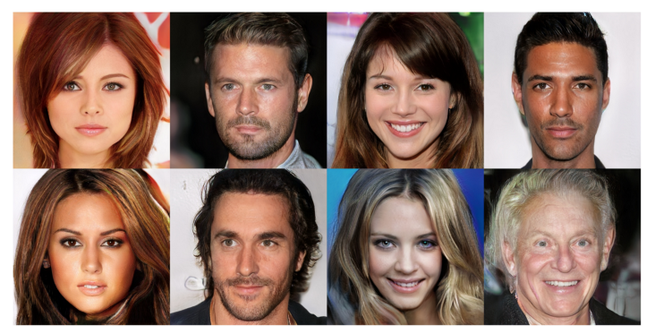
Application

Slide 19
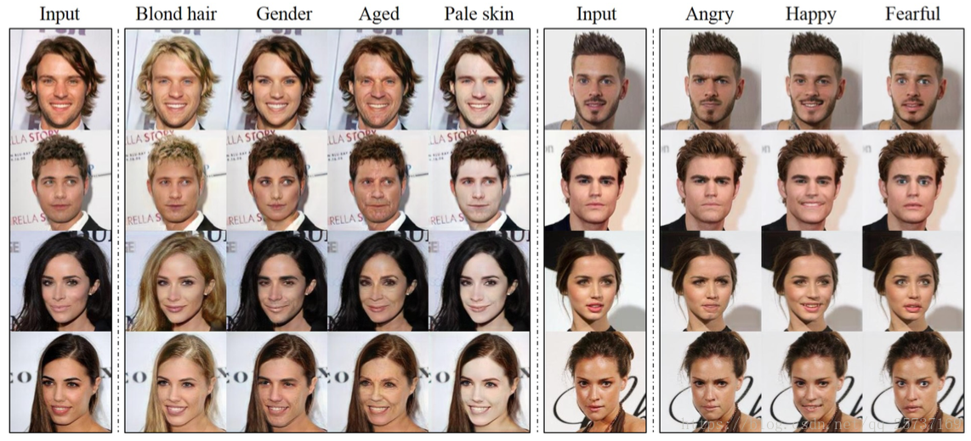
Application

Slide 20
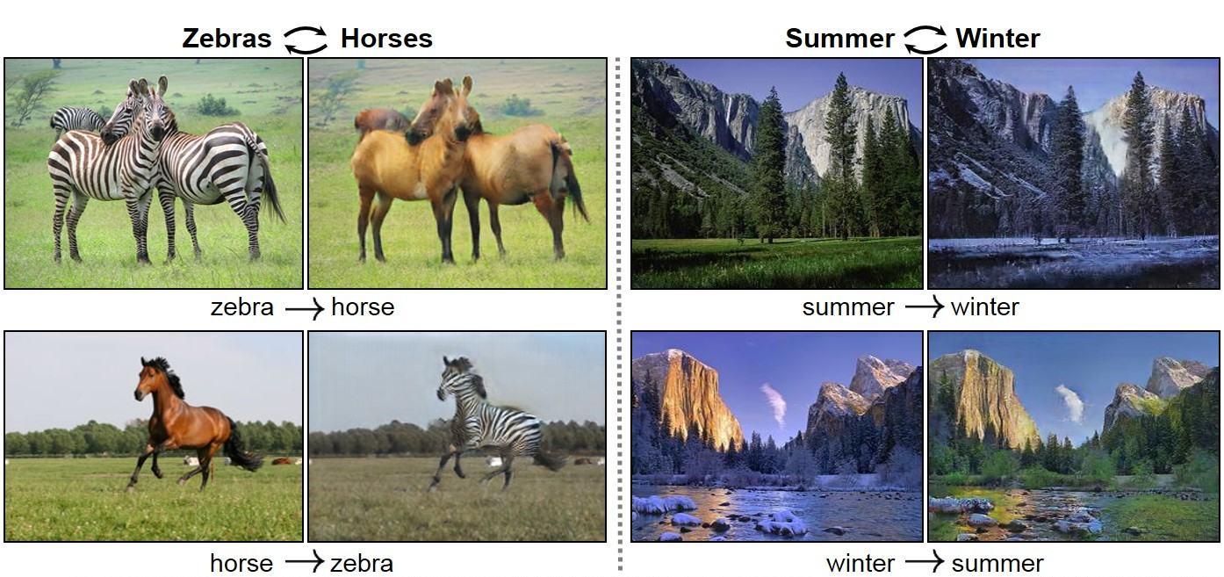
Application

Slide 21
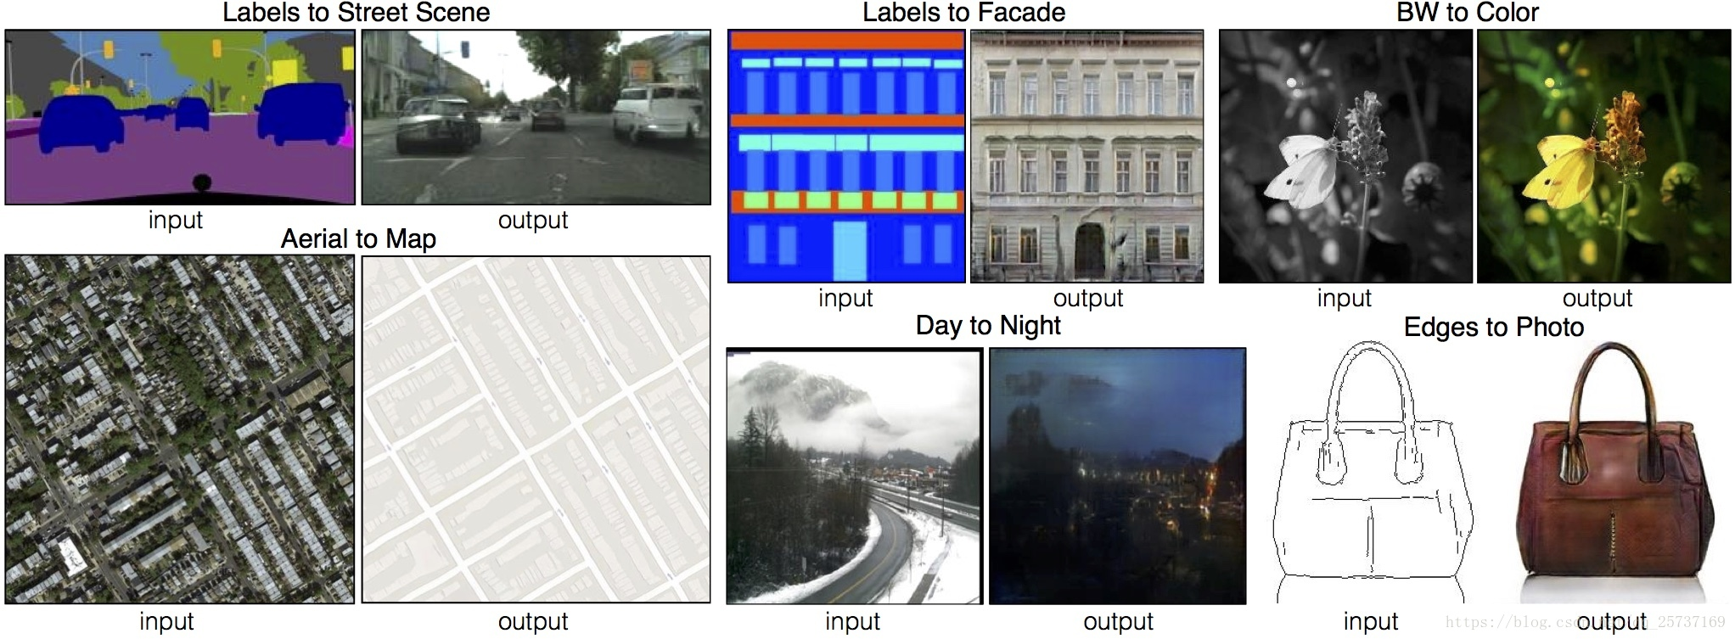
Application

Slide 22
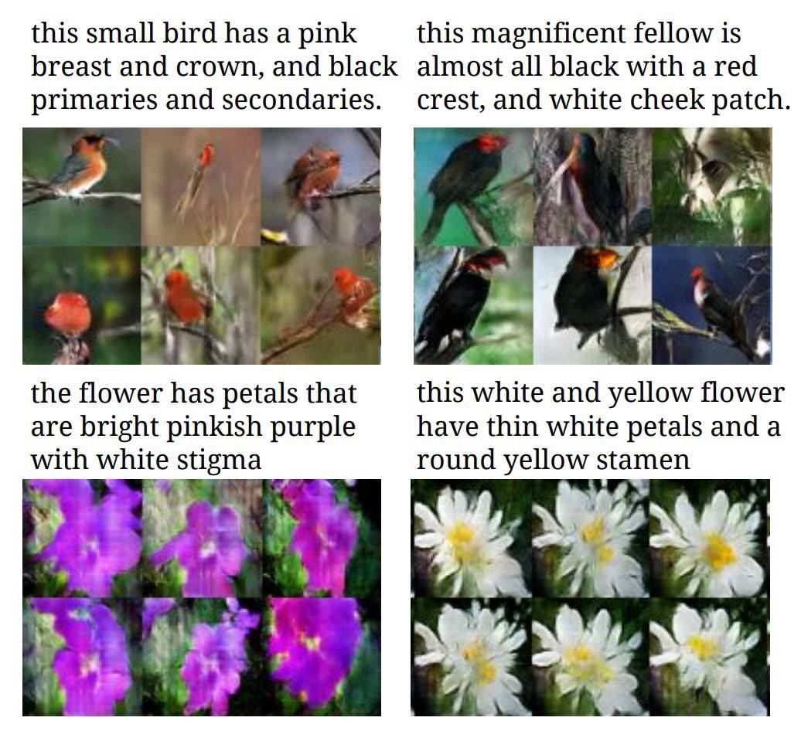
Application

Slide 23
THANK YOU FOR WATCHING !

Slide 24
Application

Slide 25
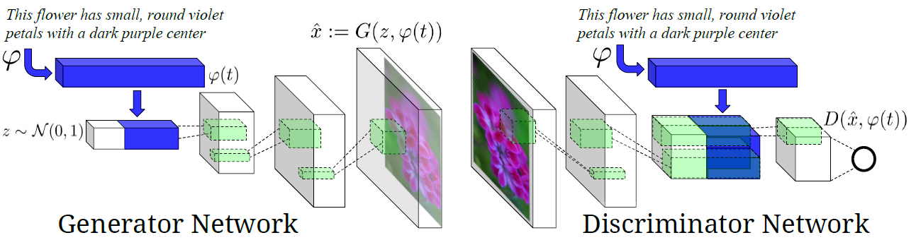
Application
GAN-INT-CLS
03
FTGAN

Slide 26
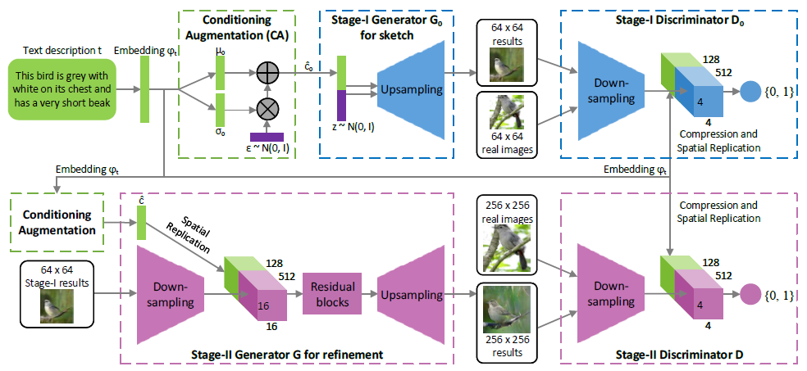
Application
StackGAN

Slide 27
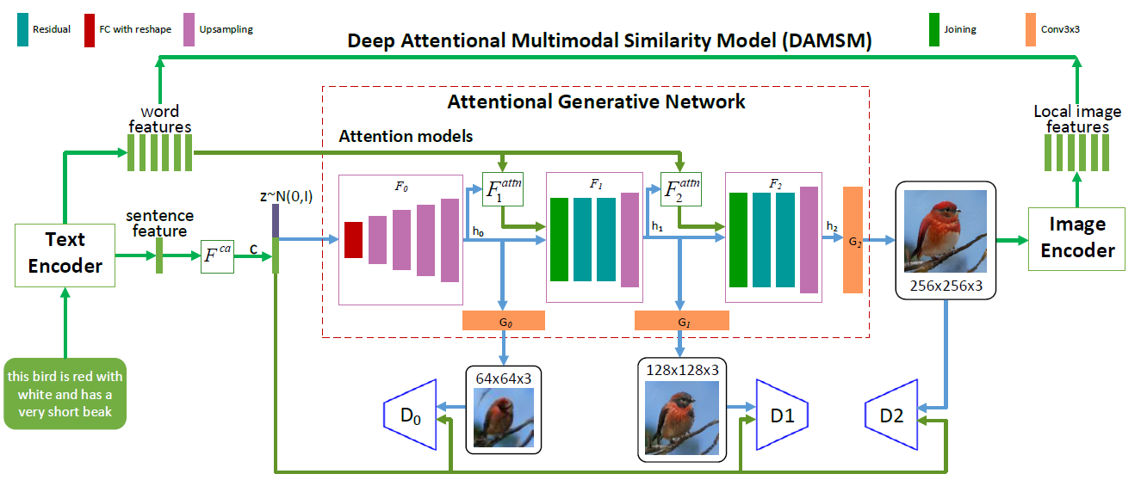
Application
AttnGAN

Slide 28
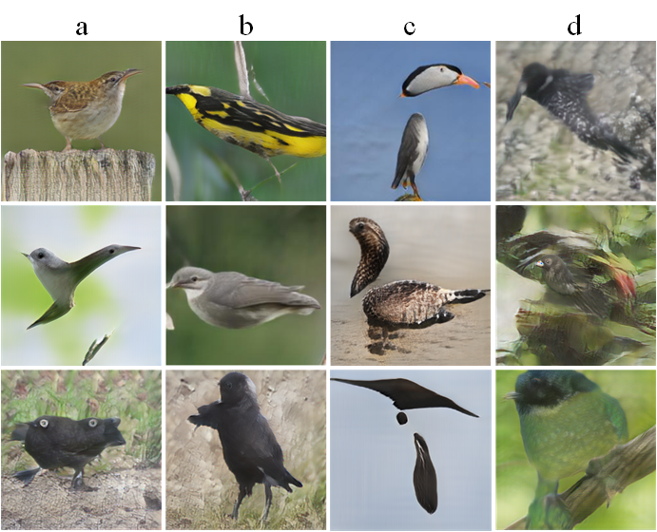
Application

Slide 29
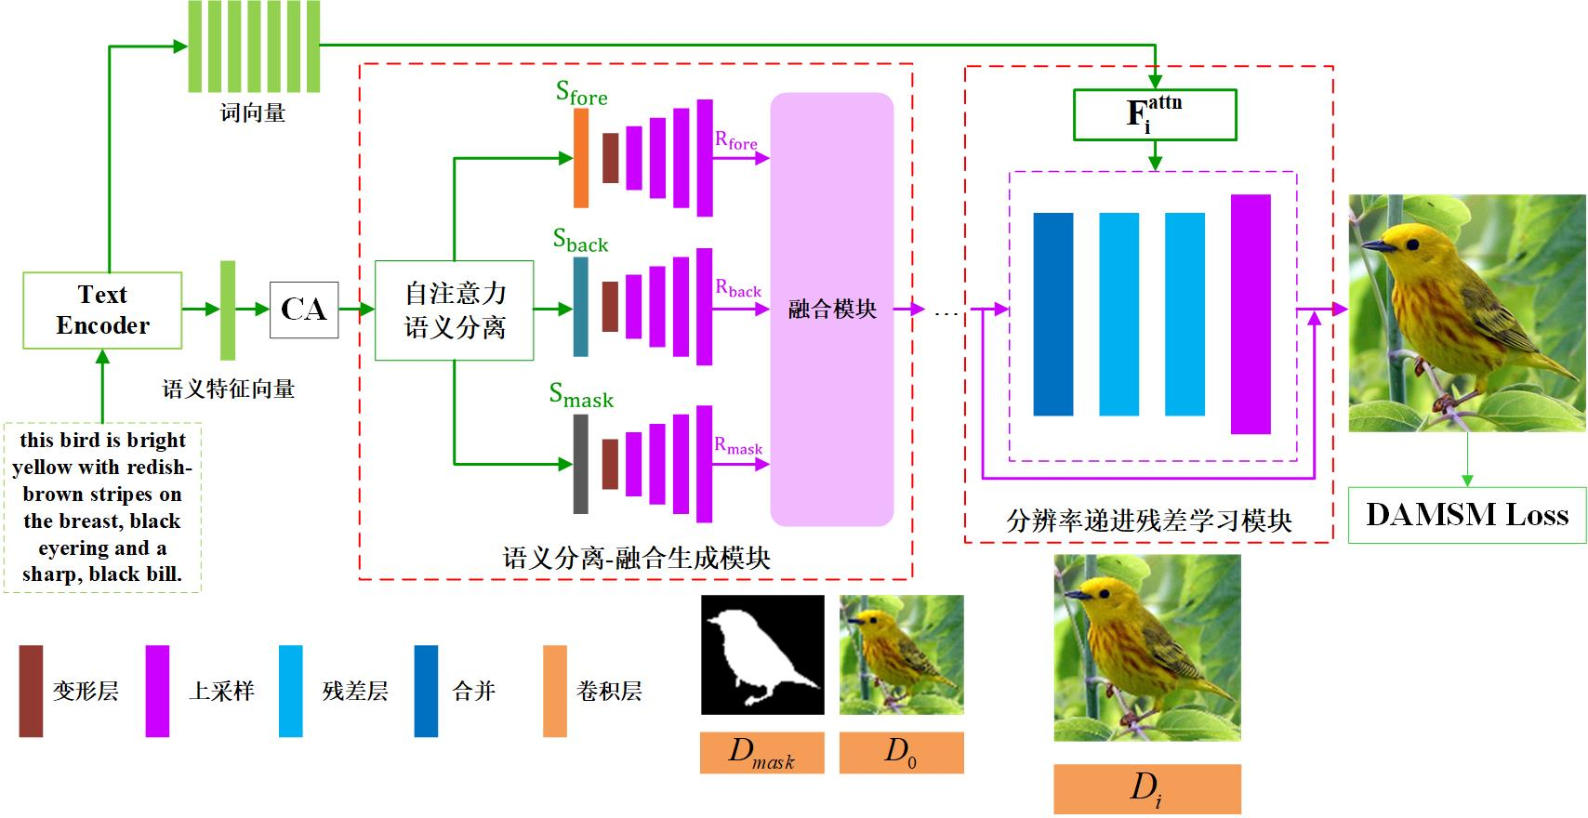
Application

Slide 30
Application

Slide 31
Application

Slide 32
Application

Slide 33
Application

Slide 34
Application

